Slide 1

PYTHON FOR DATA ANALYTICS CAPSTONE PROJECT
BY UCHENNA OHUROGU

Slide 2
SOLUTION METHODOLOGY
OBJECTIVE: Presenting an analytical solution to help a company trying to control attrition by answering the following questions;
1. What type of employees are leaving ?
2. Which employees are prone to leave next?
Using data analytics to generate meaningful insights and present these insights inform of visualizations from the available data provided by the company. The following analytical techniques were implemented;
STEP 1: UNDERSTANDING THE VARIOUS FEATURES OF THE DATASET AND WHICH FEATURES ARE OF IMPORTANCE TO THE OBJECTIVE OF OUR ANALYSIS

Slide 3
SOLUTION METHODOLOGY
STEP 2: UNIVARIATE ANALYSIS STEP 3: BI/MULTIVARIATE ANALYSIS
An Analysis of individual information of Employees who left the company
An Analysis of individual information of Existing Employees
The visualized output of both analysis are compared to draw out trends and insights
An Analysis of 2 or more information of Employees who left the company
An Analysis of 2 or more information of Existing Employees
The visualized output of both analysis are compared to draw out trends and insights

Slide 4
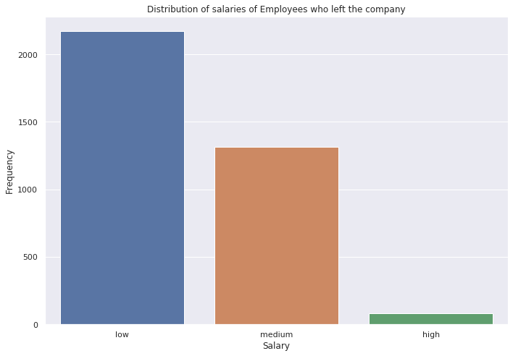
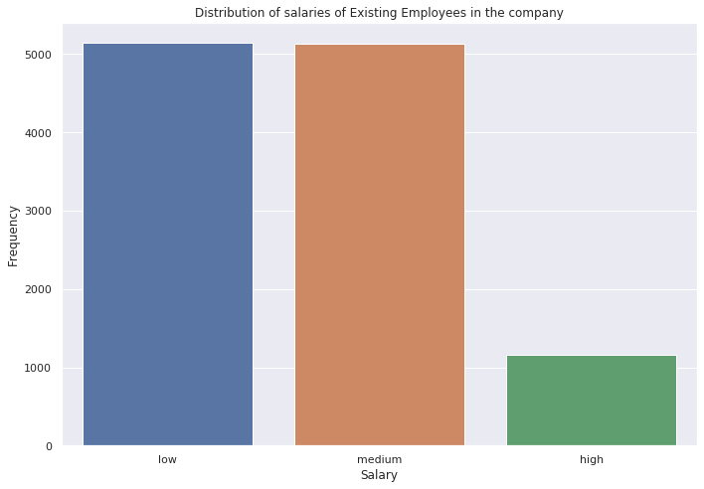
VISUALIZATION OF METHODOLOGY
STEP 2: UNIVARIATE ANALYSIS
This stage entails analysing each important feature of the dataset
CHARTS SHOWING THE DISTRIBUTION OF SALARIES FOR BOTH CATEGORIES OF EMPLOYEES

Slide 5
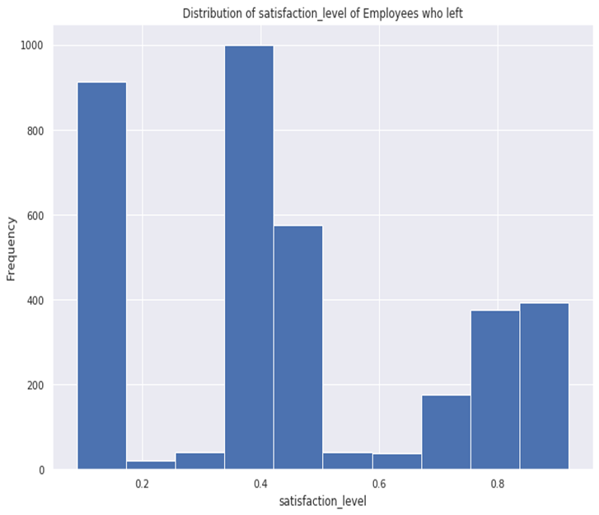
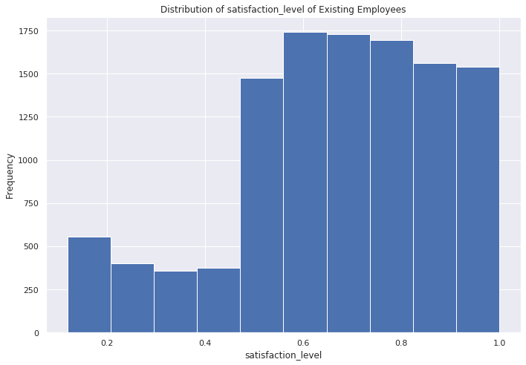
VISUALIZATION METHODOLOGY CONTD
CHARTS SHOWING THE DISTRIBUTION OF SATISFACTION LEVEL FOR BOTH CATEGORIES OF EMPLOYEES

Slide 6
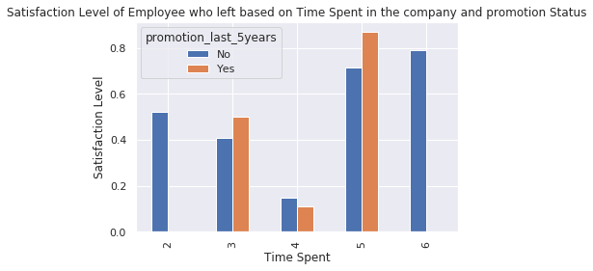
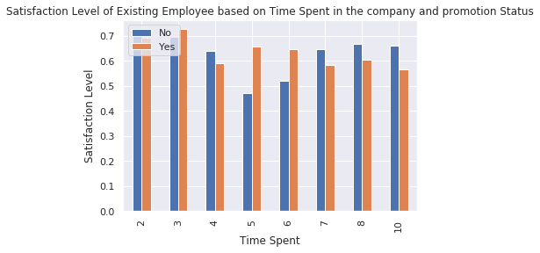
VISUALIZATION METHODOLOGY CONTD
STEP 3: BI/MULTIVARIATE ANALYSIS
This step involves analysing multiple features of information of the dataset, generating insights.
CHARTS SHOWING THE DISTRIBUTION OF SATISFACTION LEVEL BASED ON TIME SPENT FOR BOTH CATEGORIES OF EMPLOYEES

Slide 7
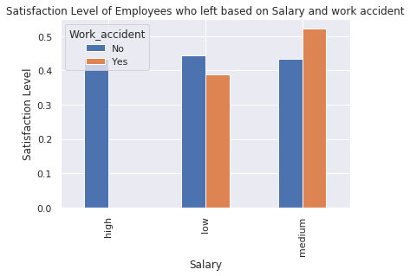
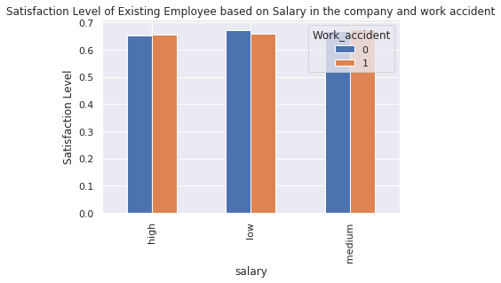
VISUALIZATION METHODOLOGY CONTD
CHARTS SHOWING THE DISTRIBUTION OF SATISFACTION LEVEL BASED ON SALARY AND WORK ACCIDENTS FOR BOTH CATEGORIES OF EMPLOYEES

Slide 8
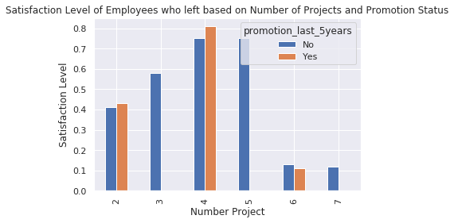
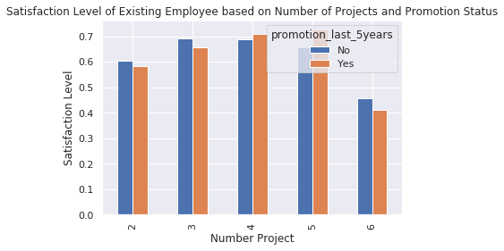
VISUALIZATION METHODOLOGY CONTD
CHARTS SHOWING THE DISTRIBUTION OF SATISFACTION LEVEL BASED ON NUMBER OF PROJECT AND WORK PROMOTION STATUS FOR BOTH CATEGORIES OF EMPLOYEES

Slide 9
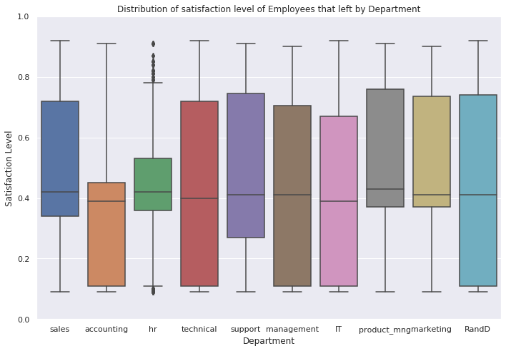
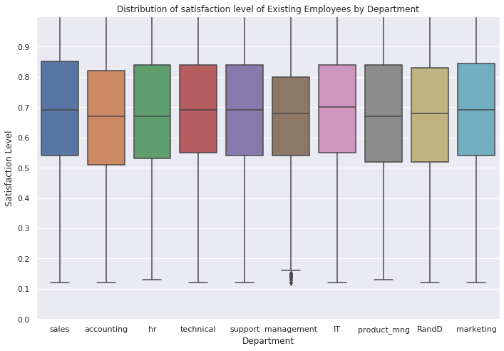
VISUALIZATION METHODOLOGY CONTD
CHARTS SHOWING THE DISTRIBUTION OF SATISFACTION LEVEL BY DEPARTMENTS FOR BOTH CATEGORIES OF EMPLOYEES

Slide 10

STEP 4: INSIGHTS & OBSERVATIONS
After examining the data of Employees existing and those who left the company, the following insights and observations were found.
From Chart 2, the average satisfaction level of employees who left was below average of 45% while existing employees was around 67%, further analysis were carried out and it was discovered that about 65% of employees who left had a satisfaction level below 45%. Diving deeper into why employees who left had a low satisfaction level, it was discovered that 99.6% of them where not promoted within the last 5 years.
Hence a major factor as to why employees are leaving is due to low salary remuneration and no promotion within the last 5 years of working for the company, which ultimately lead to employees having low satisfaction level on the job and opting to leave the company.
From the insight derived from satisfaction level of employees who left, it is important we analyse the existing employees within the same range of satisfaction level (below average of 45%) that made employees leave. Doing this, it was discovered that 13% of Existing Employees are within this range of which 97.7% of them haven’t been promoted within the last 5 years of working for the company.
Hence Existing Employees having a satisfaction level below average of 45% and have not been promoted within the last 5 years are prone to leave the company.

Slide 11
STEP 5: RECOMMENDATIONS
RECOMMENDATION: To control attrition, the company should identify and compensate employees in diverse ways such as promotion or an increase in salary so as to increase their satisfaction level and loyalty to the company.
From Chart 3, Employees who left that spent 4 years working in the company had a low satisfaction level below 45% and were not promoted.
However, for existing employees, regardless of the time spent working in the company they have a moderate satisfaction level and were promoted within the last five years excluding employees that spent 5 years In the company.
Therefore, if the company can look to continue to improve in those areas then the satisfaction level of existing employees would continue to increase and the attrition will be effectively controlled. are prone to leave due to their low satisfaction level

Slide 12
STEP 5: RECOMMENDATIONS CONTD
From Chart 4, The salary framework of those that left the company that had work related accidents was within the low and medium salary income earners and their satisfaction level was estimated to be about 50%.
RECOMMENDATION: In controlling attrition, the company would also need to put in place a well defined salary structure and improve on its reward system. For example, routine appraisals should be introduced in order to improve the satisfaction level of employees who remain at the company.

Slide 13
STEP 5: RECOMMENDATIONS CONTD
From Chart 5, The insight gleaned was that as the number of projects embarked upon by the company increased, the satisfaction level of employees began to decline.
RECOMMENDATIONS: To prevent future attrition, the number of projects allocated to a single employee should be considered and not be enormous for them, to ensure employees don’t get overwhelmed and lose enthusiasm working on their job, which may lead to the satisfaction level of employees decreasing, and then in turn may lead to them leaving the company.

Slide 14

THANK YOU

